Slide 1
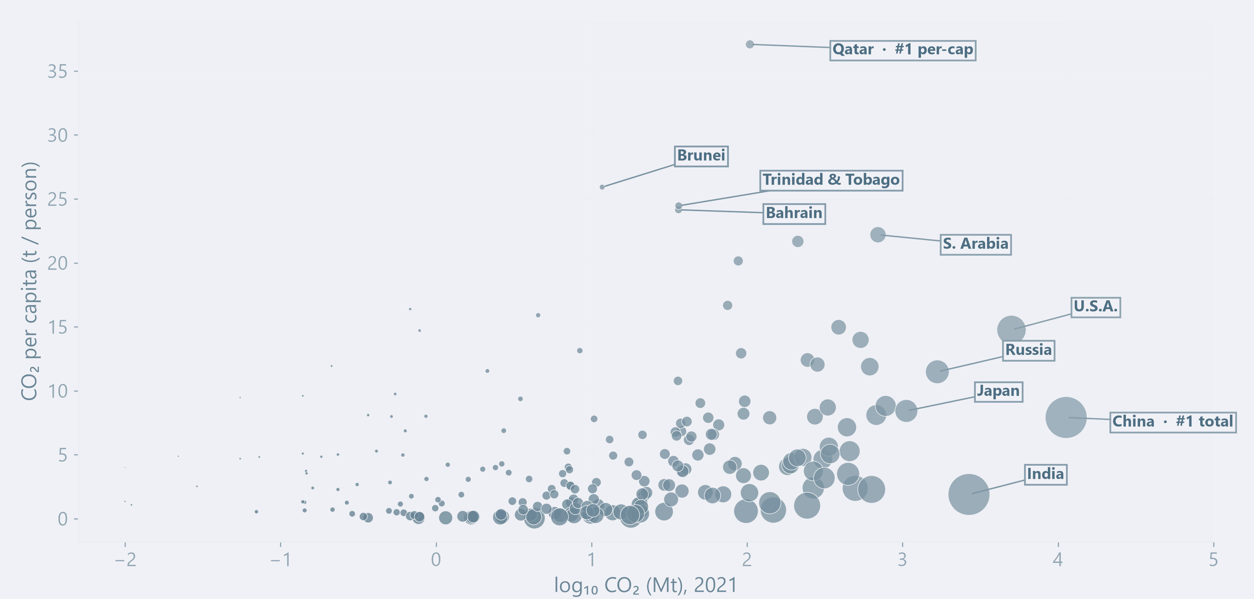
STORY · GROUP PROFILES · REDRAW BLUEPRINT
Model groups should reveal what simple rankings miss.
STORY TO TELL
·
Profile separation
Final cluster labels will colour each country; position shows scale and intensity, while size keeps population visible.
Explain which emissions features distinguish the validated groups.
P
·
Representative countries
Name a few typical members only after the final labels are frozen.
P
P
P
·
Why it matters
T
Show what the model adds beyond total and per-capita rankings.
T
T
T
T
GROUPS
T
Total Top-5
P
Per-capita Top-5
Others · area = population
PREPARED BY · [SHEN RUITING]
01 / 03
Notes:
This slide is a redraw blueprint for the final cluster-labelled country view. A scatter plot remains appropriate because position preserves two interpretable measures: total CO2 on the horizontal axis and CO2 per person on the vertical axis; bubble area represents population. After the final model is frozen, colour every country by its validated group and directly label only representative members. Replace the headline with the strongest verified finding rather than reporting K or silhouette again. Small countries may remain difficult to see, so use outlines or labels selectively. Generative AI supported layout wording and visual refinement; all numerical claims must be regenerated from the final labelled dataset.

Slide 2
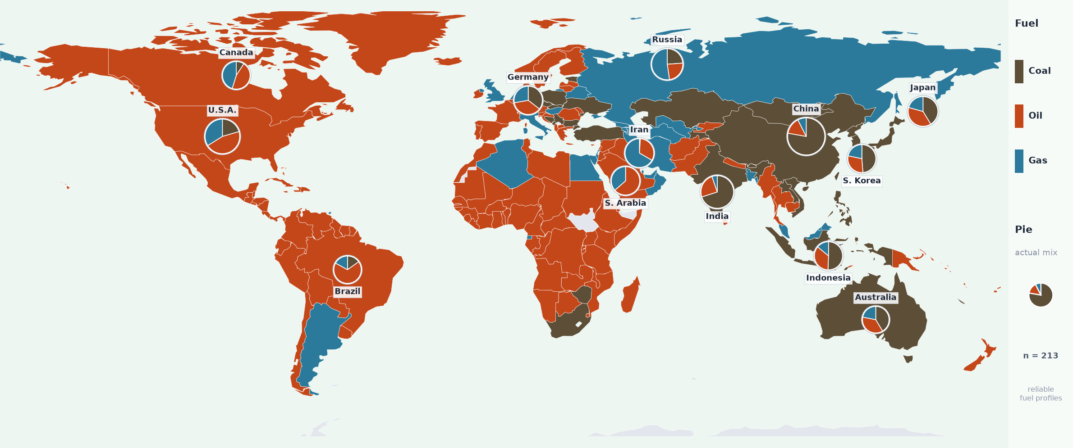
STORY · GROUP GEOGRAPHY · REDRAW BLUEPRINT
The final groups will reveal whether emissions profiles follow geography.
Country colour will show the final model group; labels will identify representative countries and regional concentrations.
SPATIAL PATTERN
Identify regional concentration or geographic mixing after labels are frozen.
WHY IT MATTERS
Show whether similar emissions profiles cross regions—and whether neighbours differ.
PREPARED BY · [SHEN RUITING]
02 / 03
Notes:
This slide reuses the established world-map composition but must be redrawn with the final K-means labels. Country fill should encode the fixed group colour, while selected labels identify representative or surprising members. If confidence or stability is available, use a restrained outline or transparency cue rather than adding a second large legend. The final headline must state the verified spatial pattern—for example, concentration, dispersion or regional mixing—rather than merely saying that groups exist. Countries excluded from modelling should appear in a neutral no-model-result colour. Generative AI supported the storyboard and layout refinement; the map, labels and all claims must be regenerated from the final model output.

Slide 3
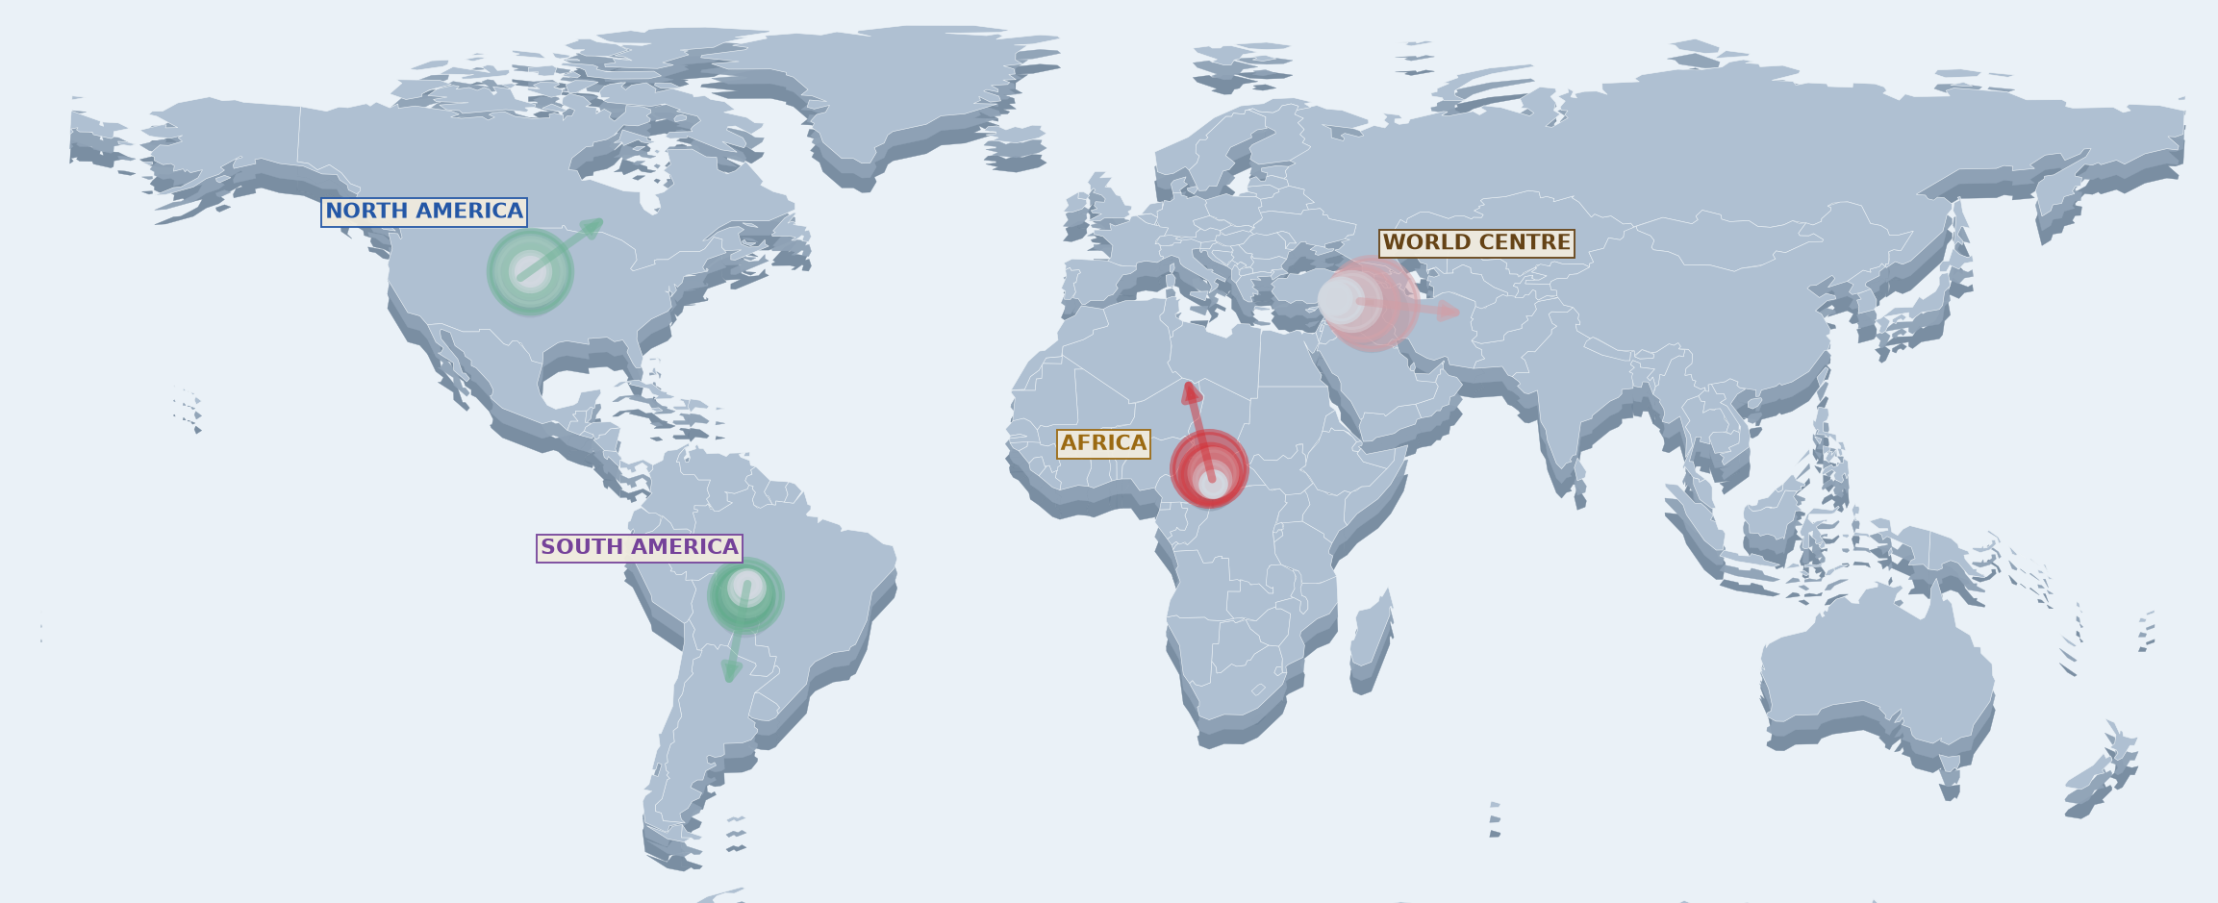
STORY · GROUP TRAJECTORIES · REDRAW BLUEPRINT
Group-level centres will connect model structure with spatial change.
STORY TO TELL
Emissions-weighted centres will be recalculated by final model group; point size marks time and arrows show direction only.
·
Time–space synthesis
Recalculate five two-year centres for every validated model group.
·
Direction and distance
Directly label the largest and smallest shifts in kilometres.
·
Interpretation
Explain which countries or regions drive each group-level movement.
TIME
2013 → 2021
+
ROSE
−
FELL
ARROWS = DIRECTION ONLY
WORLD ≈585 km ESE
PREPARED BY · [SHEN RUITING]
03 / 03
Notes:
This slide is reserved for a group-level redraw of the existing time-space trajectory map. After final labels are available, join them back to the country-year panel and calculate an emissions-weighted geographic centre for each group at the same five two-year observations. Fixed group colours should match the scatter plot and choropleth. Circle size represents time, arrows indicate direction only, and movement distance must be labelled explicitly so viewers do not infer distance from arrow length. The final headline should name the most important contrast between groups and identify likely geographic drivers. Generative AI supported the storyboard and layout refinement; all trajectories and interpretations require verification from the labelled data.

